Slide 1
Four Sides to Every Story: Perspectives of Psychiatry
JOHN M. TALMADGE, M.D.
Clinical Professor of Psychiatry
The U.T. Southwestern Medical Center
By PresenterMedia.com

Slide 2
four SIDES TO EVERY STORY

Slide 3
Practical Tip: To Remember the Four Sides, Remember the acronym “HIDE.”
HIDE stands for:
HAS
IS
DOES
ENCOUNTERS

Slide 4

The Central Idea
Disease
Dimensions
Life Story
Behavior
“What the patient encounters.”
“What the patient does.”
“Who the patient is.”
“What the patient has.”
The “D” in “HIDE.”0
And Another
The “H” in “HIDE.”
The “I” in “HIDE.”
The “E” in “HIDE”
One single method cannot explain all psychiatric conditions. We need to consider every patient from four points of view.
This diagram shows the four perspectives, the foundation of The Johns Hopkins Model.These
can be easily remembered with the acronym “HIDE.”
Has
Is
Does
Encounters

Slide 5

The Disease Perspective: What the patient has
Etiology
Pathology
Clinical Syndrome
What causes the system to break down
What is the broken part of the system
The pattern of signs and symptoms of illness
In general medicine, examples include infections, neoplasms, immune deficiencies, hormonal deficits, physical trauma, system failures, etc.
An example in psychiatry is dementia, where cognitive decline is related to a loss of brain tissue. Schizophrenia is now thought to be a brain disease linked to loss of gray matter. Psychiatry has not advanced to the point where we precisely understand (at a biological level) the etiology of most mental disorders.
For example, in general medicine we say that cough, chest pain, shortness of breath, and expectoration make up a pulmonary syndrome.
Defining psychiatric syndromes is challenging and at times controversial, because we do not have scientific understanding equal to the medical knowledge of other body systems.

Slide 6
Summary Points: The Disease Perspective
Concerns an abnormality in the structure or function of the brain expressed in the development of a syndrome
Has an underlying conceptual triad of clinical syndrome, pathology, and etiology
Applies to psychiatric conditions that a person has
Suggests curing as a treatment goal

Slide 7
The Dimensional Perspective: Who the patient is
Potentials
Provocations
Responses
Where an individual rests on the relevant dimension (intelligence, resilience, extroversion etc.)
The specific circumstances of the poor fit for the individual
The feelings and behavior that result from the poor fit
Intelligence
Temperament
-Neuroticism
-Extraversion
-Openness
-Agreeableness
-Conscientiousness
“Using one’s gifts”
Example: A person with average intelligence who grows up in a high-achieving family may inadvertently be pushed by the family beyond his abilities to the point of distress and maladaptive behavior. Or a shy, introverted person with an otherwise successful career may falter when having to lead a team or give an inspirational speech.
The condition arises from a poor fit between who the person is and his circumstances. Treatment consists of helping him recognize and accept who he is, helping him adapt to who he is by noticing, anticipating, managing and avoiding circumstances that provoke distress.

Slide 8
Summary Points: The Dimensional Perspective
Focuses on individual psychological dimensions that are universal, measurable, and graded (cognition and temperament)
Has an underlying conceptual triad of potential, provocation, and response
Applies to psychiatric conditions that arise from who a person is
Suggests guidance as a goal.

Slide 9

The Behavior Perspective: What the patient does
Physiological Drive
Conditioned Learning
Choice
Development of a desire for the maladaptive behavior that is experienced strongly.
Maintenance of the behavior by the rules of conditioned learning theory, reinforcement/reward
Initial choice and late disruption of free choice
These three elements form a triad, and each interacts with the others to determine behavior.

Slide 10
Summary Points: The Behavior Perspective
Seeks to identify and explain disorders of individual choice
Has an underlying triad of choice, physiologic drive, and conditioned learning.
Applies to psychiatric conditions characterized by what a person does
Suggests interrupting as a goal.

Slide 11
The Life Story Perspective: What patient encounters
Setting
Sequence
Outcome
The unique situation that is the individual’s life
The unfolding of the circumstances that impact the individual
The individual’s psychological condition in relation to the stresses and challenges of life
Every individual goes through life with needs, desires, goals, and hopes.
When someone encounters life circumstances that disrupt needs, desires, goals, and hopes, they can become distressed or demoralized.
Demoralization is a state of mind in which one has the sense of losing mastery over circumstances.
There are many examples of life encounters that create understandable distress: grief and loss, disappointment and failure, anxiety-producing external forces, conflicts with others, fears about uncertainty of the future, and so on.

Slide 12
Summary Points: The Life Story Perspective
Is a personal perspective
Is based on the logic of narrative with the triad of setting, sequence, and outcome, which is produced meaningfully and understandably
Applies to psychiatric conditions that a person has encountered
Suggests rescripting as a goal.

Slide 13
The Goals of Treatment
Disease
Dimension
Life Story
Behavior
The goal is to rescript.
The goal is to interrupt or to convert.
The goal is to guide.
The goal is to support and cure, e.g. with medication
The goal of treatment depends upon the origin of a patient’s psychiatric condition.
Each perspective has a corresponding treatment goal.
Treatment goals need to be prioritized for each patient in order to maximize successful outcomes and avoid needless interventions.

Slide 14


Case Examples from Popular Stories in Film
A Practical Teaching Tool for Discussion
MOVIE CHARACTERS AS EXAMPLES
Characters in the movies can be useful for illustrating the four perspectives of psychiatry. Almost all of your students will have seen at least one of the following films, and the people portrayed demonstrate the importance of seeing the individual from all four of the perspectives.
FLIGHT
A BEAUTIFUL MIND
SILVER LININGS PLAYBOOK
28 DAYS
GOOD WILL HUNTING

Slide 15
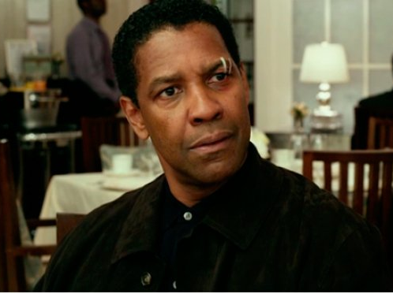
Case Example: Whip Whitaker
In the movie “Flight,” Whip Whitaker is an extremely skilled airline pilot whose performance prevents a passenger jet from crashing and killing everyone aboard. His drug and alcohol problems destroy his career despite his skill, intelligence, and strength of character.

Slide 16
If we focus only on what Whip Whitaker has (substance abuse disorder) and what he does (his erratic behavior and his episodic intoxication), can we really effectively help him?

Slide 17
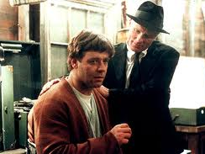
Case Example: John Nash
In the movie “A Beautiful Mind,” John Nash suffers the onset of schizophrenia during his early years as a brilliant student at Princeton.

Slide 18
If we focus only on what John Nash has (schizophrenia) and what he does (his psychotic and paranoid behavior), can we really effectively help him?

Slide 19
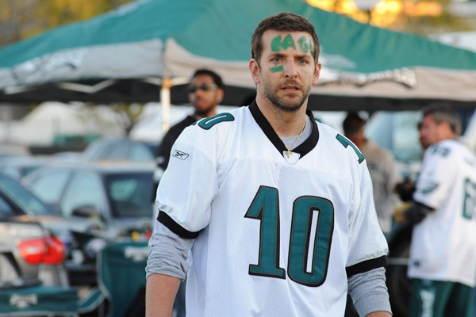
Case Example: Pat Solitano
In the movie “Silver Linings Playbook,” Pat Solitano is diagnosed with bipolar disorder and confined to a psychiatric hospital for eight months.

Slide 20
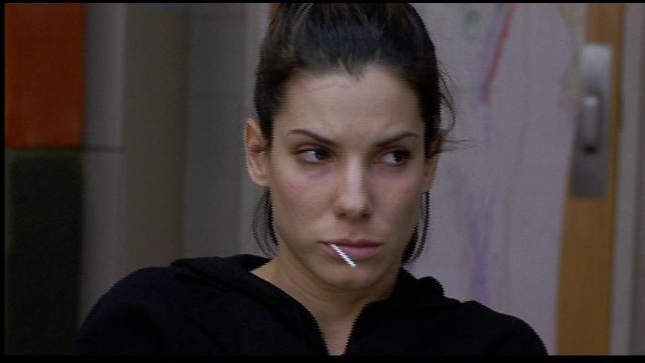
Case Example: Gwen Cummings
In the movie “28 Days,” Gwen Cummings (Sandra Bullock) chooses rehab over prison, gradually accepting that she has an addiction after resisting what the treatment program has to offer.

Slide 21
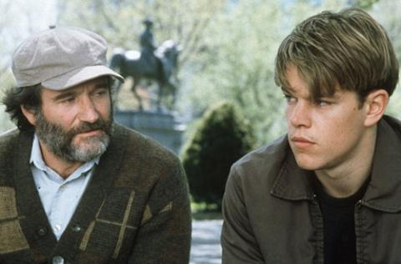
Case Example: Will Hunting
In the movie “Good Will Hunting,” therapist Sean Macguire (Robin Williams) tries to help Will work through the suffering linked to childhood abuse.

Slide 22
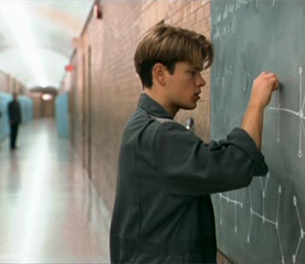
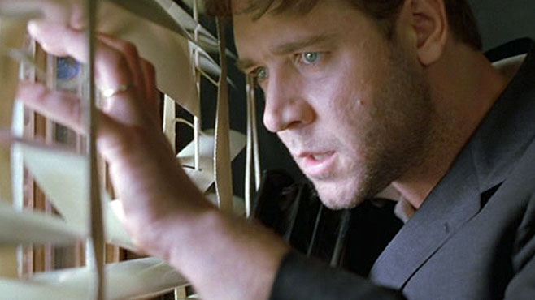
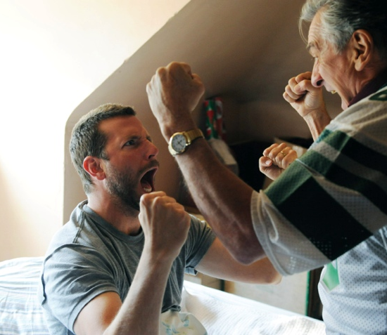
Every picture tells a different, unique story.
Will Hunting is brilliant but has suffered painful circumstances. Who he is and what he encounters are essential parts of understanding and helping him.
John Nash is brliiant but suffers from a brain disease, schizophrenia. What he has, the syndrome that disables him, can be treated most effectively if all four perspectives are part of the approach.
Pat Solitano suffers from a disorder that has biological roots (bipolar disorder), and the condition responds well to medication. His behavior (what he does) gets him in serious trouble.
However, as the story shows in the movie, his recovery is intertwined with who he is as a person and what he has encountered in life.

Slide 23
The Central Idea
Disease
Dimensions
Life Story
Behavior
“What the patient encounters.”
“What the patient does.”
“Who the patient is.”
“What the patient has.”
The “D” in “HIDE.”0
And Another
The “H” in “HIDE.”
The “I” in “HIDE.”
The “E” in “HIDE”
One single method cannot explain all psychiatric conditions. We need to consider every patient from four points of view.
This diagram shows the four perspectives, the foundation of The Johns Hopkins Model.These
can be easily remembered with the acronym “HIDE.”
Has
Is
Does
Encounters

Slide 24
The Goals of Treatment
Disease
Dimension
Life Story
Behavior
The goal is to rescript.
The goal is to interrupt or to convert.
The goal is to guide.
The goal is to support and cure, e.g. with medication
The goal of treatment depends upon the origin of a patient’s psychiatric condition.
Each perspective has a corresponding treatment goal.
Treatment goals need to be prioritized for each patient in order to maximize successful outcomes and avoid needless interventions.

Slide 25
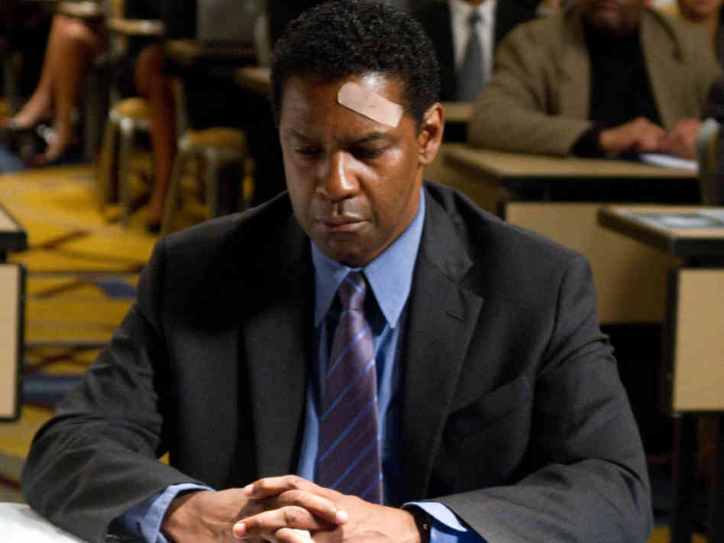
Discussion
Pick the character from one of the movies you have seen.
Consider the character from each of the four perspectives.
What the person HAS.
Who the person IS.
What the person DOES.
What the person ENCOUNTERS.

Slide 26
SUMMARY
Disease
Dimensions
Life Story
Behavior
“What the patient encounters.”
“What the patient does.”
“Who the patient is.”
“What the patient has.”
The “D” in “HIDE.”0
And Another
The “H” in “HIDE.”
The “I” in “HIDE.”
The “E” in “HIDE”
One single method cannot explain all psychiatric conditions. We need to consider every patient from four points of view.
This diagram shows the four perspectives, the foundation of The Johns Hopkins Model.These
can be easily remembered with the acronym “HIDE.”
Has
Is
Does
Encounters

Slide 27
CONTACT INFORMATION:
Find me on the web at http://johntalmadge.com
JOHN M. TALMADGE, M.D.
Clinical Professor of Psychiatry
The University of Texas Southwestern Medical Center
john.talmadge@utsouthwestern.edu
214-673-9250
By PresenterMedia.com

